Slide 1

TP5 - Shaders
Computer Graphics
MIEIC
Concepts and Practice
Teresa Matos
26-27 March 2020

Slide 2
From object definition to rendering
Objects are defined by vertices, indices, normals and texture coordinates
Let’s see how this data is used to render objects in the scene
…
initBuffers(){
this.vertices = [...]
this.indices = [...]
this.normals = [...]
this.texCoords = [...]
}
Graphics
Pipeline
Object definition using CGFobject class
Rendered scene in screen

Slide 3
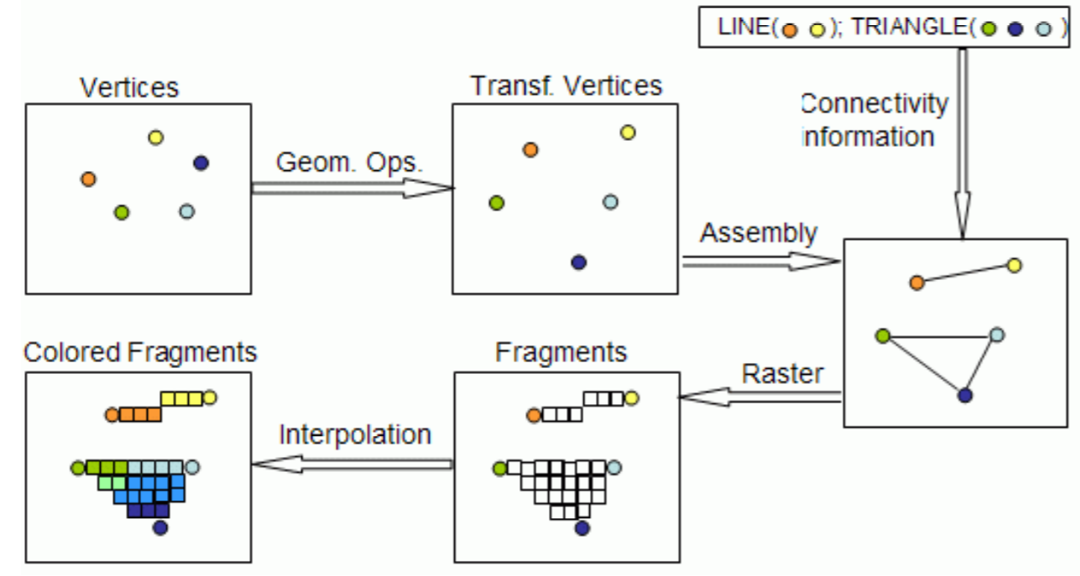
Graphics Pipeline - Visualization
Vertices positioned in screen space
Type of primitive defined in CGFobject
Vertices defined for CGFobject
Connecting vertices according to indices from CGFobject
Fragments contains data for each pixel of the primitive’s vertices
Remaining fragments are defined using interpolation

Slide 4
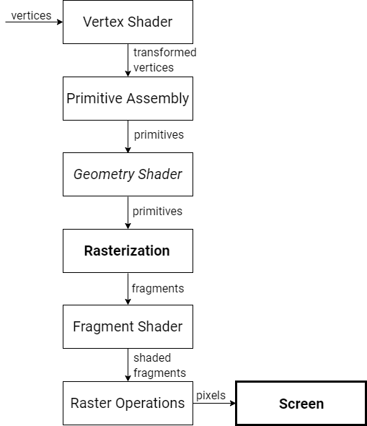
Graphics Pipeline
Inputs
Vertex shading
Primitive assembly
Geometry shading
Projection and rasterization
Fragment shading
Raster operations
Output to screen

Slide 5
Shaders
Small programs receive and manipulate data on the 3D scene:
Vertex shaders - Manipulate and define properties for each vertex
Fragment shaders - Manipulate and define properties for each fragment
Custom data may be passed to the shaders from the application
Data may be passed from vertex to fragment shader (not inversely)

Slide 6
Shaders in WebGL/WebCGF
In WebGL, shaders may be loaded as strings and compiled in real time
To apply shaders to a scene using WebCGF, these are the general steps:
Create the shader files
Load the created files to a CGFshader class object
Set CGFshader object as the scene’s active shader
Pass values from application to shaders (optional)

Slide 7
1 Creating Shaders - Structure
Shader may be defined in .vert or .frag files, for vertex or fragment shaders
A shader program commonly contains:
List of input/output and uniform variables
A main() function, where input data is processed and output is returned
The main() function runs for each vertex or for each fragment

Slide 8
1 Creating Shaders - Vertex Shader
A vertex shader receives input relative to:
each vertex (position, normal, texture coordinate)
lights, materials, camera (for illumination model and other functionalities)
custom data provided from the application
A vertex shader creates as output:
the calculated position for each vertex
data to be passed to the fragment shader

Slide 9
1 Creating Shaders - Vertex Shader Example
attribute vec3 aVertexPosition;
attribute vec3 aVertexNormal;
attribute vec2 aTextureCoord;
uniform mat4 uMVMatrix;
uniform mat4 uPMatrix;
uniform mat4 uNMatrix;
...
void main() {
...
gl_Position = uPMatrix * uMVMatrix * vec4(aVertexPosition, 1.0);
}
Input variables
Main function, processes each vertex
Output vertex position

Slide 10
1 Creating Shaders - Variables
attribute vec3 aVertexPosition
Qualifier
Data Type Qualifiers
uniform - read-only global input, from WebGL or application
attribute - read-only per-vertex input to vertex shader
varying - writable output (vertex shader)
- read-only input (fragment shader)
const - read-only compile-time constant

Slide 11
1 Creating Shaders - Variables
attribute vec3 aVertexPosition
Type
Data Type
Scalars - bool, int, float, …
Vectors - vec2, vec3, vec4, …
Matrices - mat2, mat3, mat4, …
Textures sampler1D, sampler2D, sampler3D, …
And others

Slide 12
1 Creating Shaders - Variables in Vertex Shader
attribute vec3 aVertexPosition;
attribute vec3 aVertexNormal;
attribute vec2 aTextureCoord;
uniform mat4 uMVMatrix;
uniform mat4 uPMatrix;
uniform mat4 uNMatrix;
...
void main() {
...
gl_Position = uPMatrix * uMVMatrix * vec4(aVertexPosition, 1.0);
}
position of each vertex (attribute) as 3D vector (vec3)
global (uniform) model-view 4x4 matrix (mat4)

Slide 13
1 Creating Shaders - Vertex Shader main() function
void main() {
...
gl_Position = uPMatrix * uMVMatrix * vec4(aVertexPosition, 1.0);
}
Output vertex position
Input 3D position vector for vertex (as defined in application)
Projection Matrix
Applies transformations related to camera frustum
Model-View Matrix
Represents transformations applied to scene and camera position

Slide 14
Model-View-Projection Matrix
Object space
World space
Camera space
Clip space
Model Matrix
Matrix representing every geometric transformation applied in the scene
View Matrix
Matrix that transforms objects according to the active camera.
It is the inverse of the camera’s transformation matrix.
Projection Matrix
Matrix that defines a viewing box (frustum) - visible area in the screen.
Coordinates outside the frustum are clipped.

Slide 15
1 Creating Shaders - Fragment Shader
A fragment shader receives as input:
Data from previous operations in the graphics pipeline (e.g., vertex shader)
Custom data from application
A fragment shader creates as output:
the color for the current fragment

Slide 16
1 Creating Shaders - Fragment Shader Example
struct lightProperties {
...
};
#define N_LIGHTS 8
uniform lightProperties uLight[N_LIGHTS];
void main() {
gl_FragColor = uLight[0].diffuse;
}
Local struct for light properties (position, ambient, diffuse,...)
Input array of lightProperties (length 8)
Main function, processes each fragment
Output fragment color

Slide 17
2 Loading Shaders using WebCGF library
The WebCGF library has a class for shaders - CGFshader
new CGFshader(gl, urlVertexShader, urlFragmentShader)
The scene has an active shader (default shader provided in library)
CGFscene.activeShader
Created shaders may be set as the scene’s active shader
CGFscene.setActiveShader(CGFshader)
To set back to default, provide CGFscene.defaultShader

Slide 18
3 Applying Shaders - Example
CGFscene.init(){
…
this.shaderA = new CGFshader(...)
}
…
CGFscene.display(){
…
this.setActiveShader(this.shaderA);
…
this.object.display();
…
this.setActiveShader(this.defaultShader);
}
Initializing shaders and other objects
Scene setup (cameras, lights, matrices)
Drawn elements affected by the custom shader

Slide 19
4 Passing Data from Application to Shaders
Data may be passed from the application to the CGFshader object
CGFshader.setUniformsValues(dictionary)
This data is accessible in the shaders as uniform variables
uniform type variableKey;
The shaders may use this data to transform the output
Key-value pair collection, equivalent to JS object

Slide 20
4 Passing Scalar Data to Shader - Example
CGFscene
this.shaderA = new CGFshader(...)
this.shaderA.setUniformsValues(
{ scale: 2.0, key:value, ...});
Vertex shader
uniform float scale;
uniform valueType key;
...
void main() {
gl_Position = uPMatrix * uMVMatrix * vec4(aVertexPosition*scale, 1.0);
}
Initializing shaders and passing uniforms’ values
Initializing the uniforms
Applying uniform data to transform the output

Slide 21
4 Passing Scalar Data to Shader - Example
What happens if the value provided to the shader is altered periodically?
CGFscene.display(){
this.scale++;
this.shaderA.setUniformsValues({scale: this.scale});
}
Sequence of frames with variation in object - Animation
Frame 1
Frame 2
Frame k
scale+1
scale +k

Slide 22
4 Passing Texture to Shader - Example
CGFscene
display(){
…
this.setActiveShader(this.shaderA);
this.texture0.bind();
this.object.display();
}
Vertex/Fragment shader
uniform sampler2D uSampler;
…
And what if we want more than one texture?
Bind texture0 to WebGL context
Where is uSampler defined?

Slide 23
4 Passing Multiple Textures to Shader
WebGL has a global array of references to textures – texture units
CGFtexture.bind(unit)
The unit parameter is the texture unit to which the texture is bound
By default, CGFscene passes the texture at unit = 0 as uSampler
pseudo-code
activeShader.setUniformsValues({uSampler: 0});

Slide 24
4 Passing Multiple Textures - Example
CGFscene.init(){
this.shaderA = new CGFshader(...)
this.texture1 = new CGFtexture(...);
this.texture2 = new CGFtexture(...);
this.shaderA.setUniformsValues({texture2: 1});
}
CGFscene.display(){
this.setActiveShader(this.shaderA);
this.texture1.bind();
this.texture2.bind(1);
this.object.display();
…
}
Passing as uniforms values the texture unit for the 2nd texture
Binding textures to units 0 and 1

Slide 25
4 Passing Multiple Textures - Example
texture coordinates from vertex shader
varying vec2 vTextureCoord;
uniform sampler2D uSampler;
uniform sampler2D texture2;
void main() {
vec4 color = texture2D(uSampler, vTextureCoord);
…
gl_FragColor = …
}
Texture passed by CGFscene
Texture passed by our code
Shader function that retrieves a texel from the sampler at specified coordinates

Slide 26
Documentation and guides
Introduction to shaders using GLSL (presentation at Moodle)
GLSL Reference Card (available on Moodle)
WebCGF documentation for CGFshader
https://paginas.fe.up.pt/~ruirodrig/pub/sw/webcgf/docs/#!/api/CGFshader
Texture2D function
https://thebookofshaders.com/glossary/?search=texture2D
WebGL Shaders Tutorial
https://webglfundamentals.org/webgl/lessons/webgl-shaders-and-glsl.html

